Slide 1
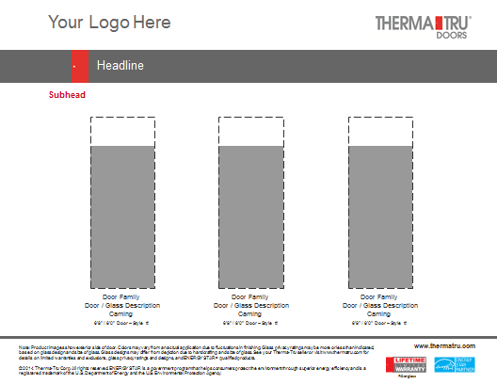
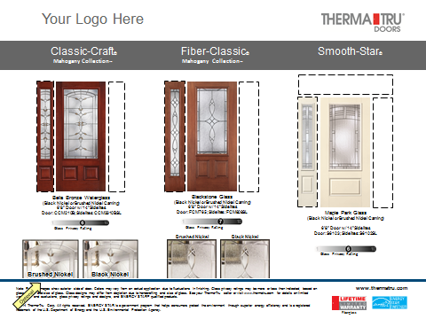
Builder Sell Sheet Program
PowerPoint Tools
February 2015

Slide 2
Fiberglass Door Header / Subhead Options
Therma-Tru Fiberglass Door Systems.
Fiberglass Door Systems From Therma-Tru.
Entry & Patio Door Systems Presented By (Builder)
Entry & Patio Door Solutions Presented By (Builder)
Beautiful, inside and out.
The beauty of choice.
Doors come to life with Therma-Tru® glass.
Classic-Craft® – Extraordinary in every way.
Classic-Craft® Premium Entryways.
Classic-Craft® Canvas CollectionTM. The premium smooth, paintable choice.
Simply beautiful products.
The beauty of fiberglass.
The easy, reliable choice.
Beautifully dependable.
Therma-Tru. You’re in expert hands.
Backed by our lifetime limited warranty.
Uncompromising quality, inside and out.
Engineered to work together.
Options to fit every entrance.
Durability and reliability through the years.
Beauty, durability and energy efficiency.
Welcome Home
Home begins at the door.
Dress up the door.
A bold entrance turns heads.
Always make a great entrance
Build your dream home for today – and the future. A beautiful front door can increase curb appeal and make a big difference when it comes time to sell.
Your new home. Your investment. Choose a beautiful and durable front door for lasting curb appeal.
Your new home. Your investment. A beautiful front door can increase curb appeal and make a big difference when it comes time to sell.

Slide 3
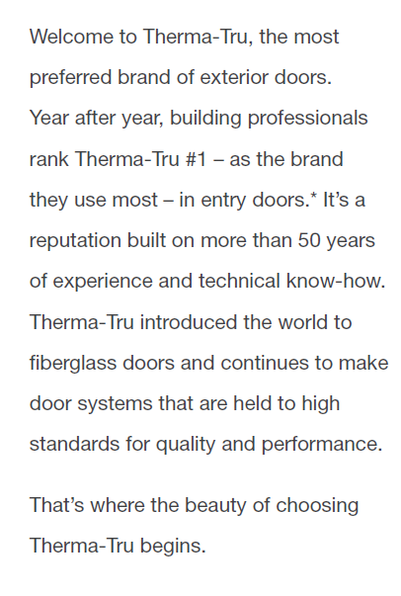
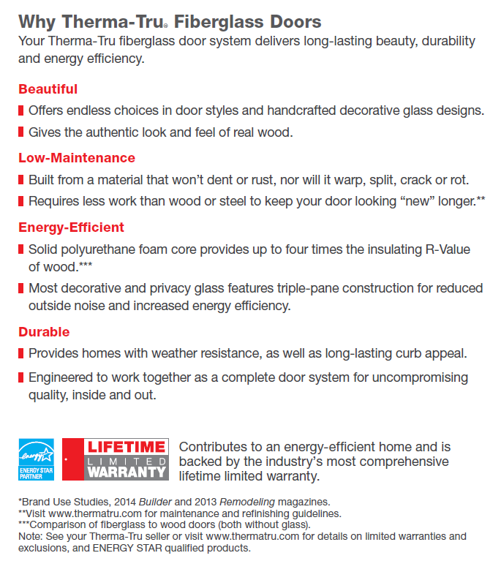
Why Therma-Tru® Fiberglass Doors

Slide 4
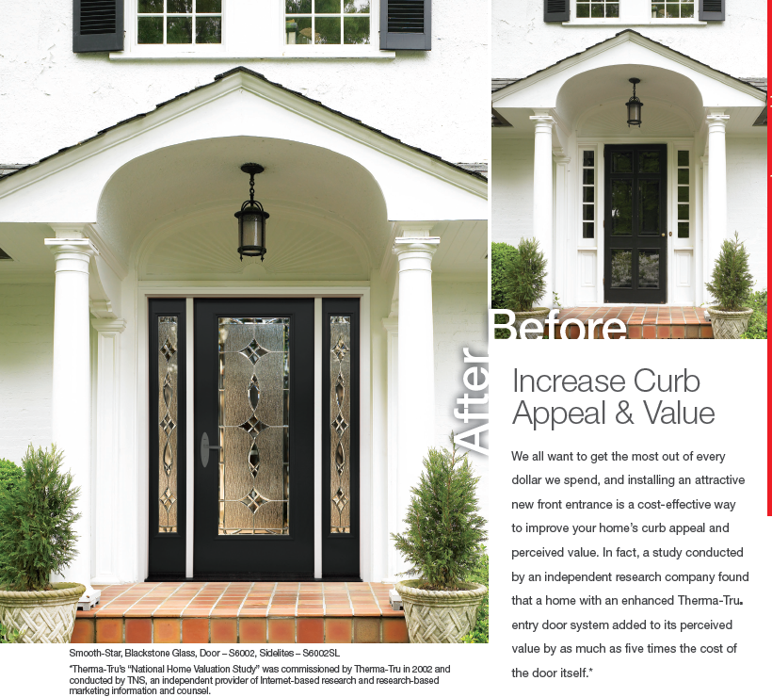
Curb Appeal

Slide 5
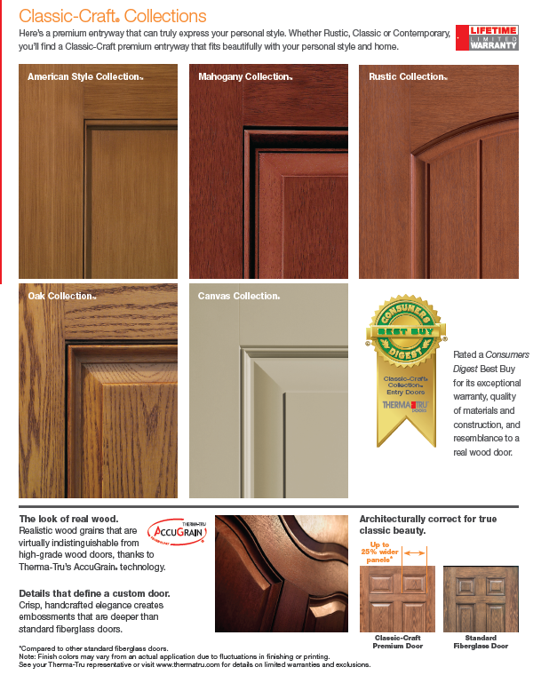
Why Classic-Craft®
The Best Buy Seal and other licensed materials are registered certification marks and trademarks of Consumers Digest Communications, LLC,
used under license. For award information, visit ConsumersDigest.com.

Slide 6
Therma-Tru® Door System & Warranty*
*Excluding primed Pine and Oak frame components.
**Excluding improper assembly of components into a door system by the distributor, dealer, builder or remodeler, and the installation of the door system.
***Excluding installations within 5 miles of a body of salt water and the finish.
****Excluding normal wear and tear.
Note: See your Therma-Tru seller or visit www.thermatru.com for details on limited warranties and exclusions.

Slide 7
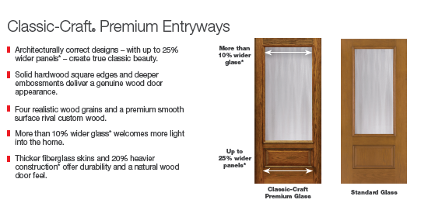
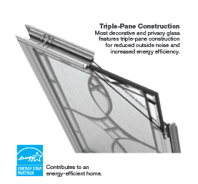
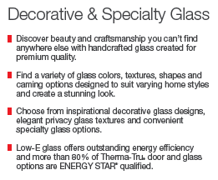
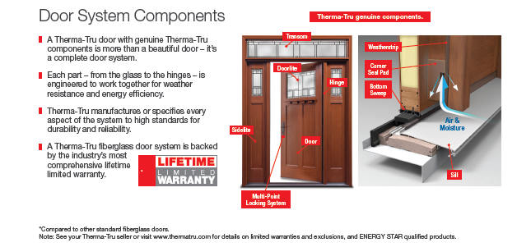
Why Therma-Tru® CC / Deco Glass / System

Slide 8
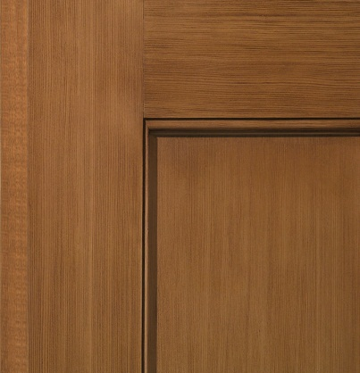
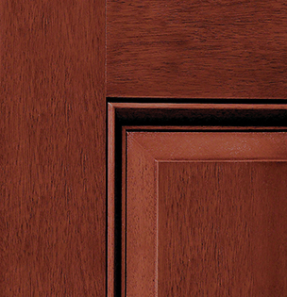
Door Selections: Classic-Craft® Collections
Classic-Craft®
Classic-Craft® American Style CollectionTM
Classic-Craft® Mahogany CollectionTM
Classic-Craft® Rustic CollectionTM
Classic-Craft® Oak CollectionTM
Classic-Craft® Canvas Collection®
American Style CollectionTM
Mahogany CollectionTM
Rustic CollectionTM
Oak CollectionTM
Canvas Collection®
Classic-Craft® Orange
Generic Gray
Fire-Rated Options
WBDR / HVHZ Options
Tru-Defense Eligible

Slide 9
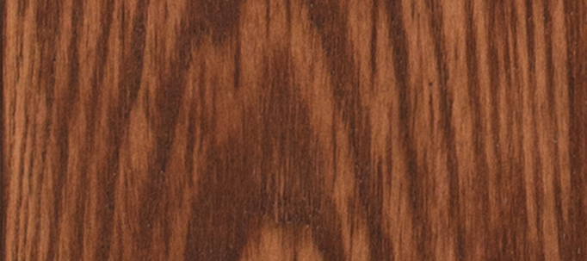
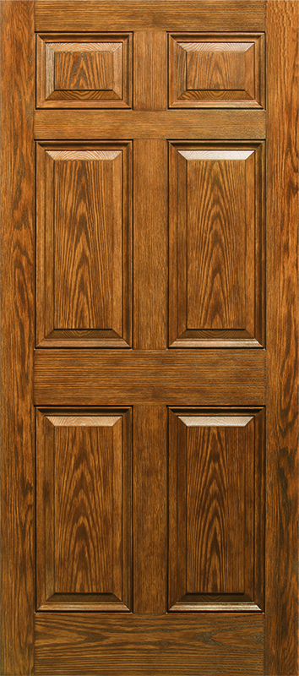
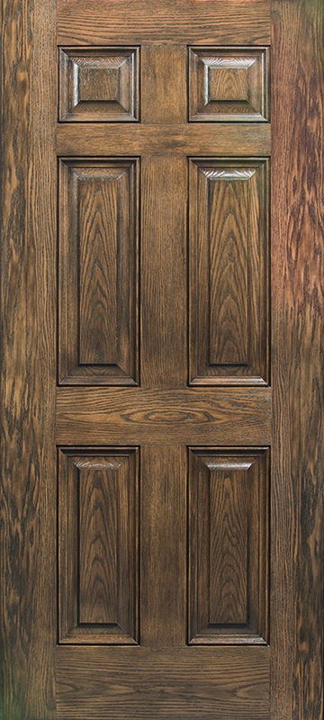
Classic-Craft® Premium Entryways
Architecturally correct for true classic beauty.
Doors designed to be architecturally correct, with proportions modeled after classic architectural principles, to create a more premium entryway.
Up to
25% wider panels*
The look of real wood.
Realistic wood grains that are
virtually indistinguishable from
high-grade wood doors, thanks to
Therma-Tru’s AccuGrain® technology.
Details that define a custom door.
Crisp, handcrafted elegance creates embossments that are deeper than standard fiberglass doors.
Classic-Craft
Premium Door
Standard
Fiberglass Door
*Compared to other standard fiberglass doors.

Slide 10
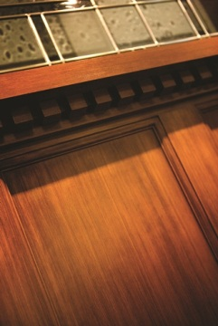
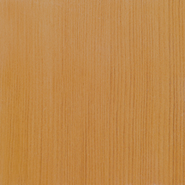
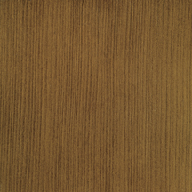
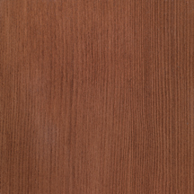
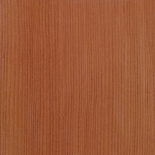
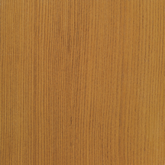
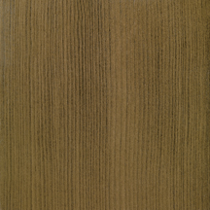
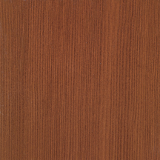
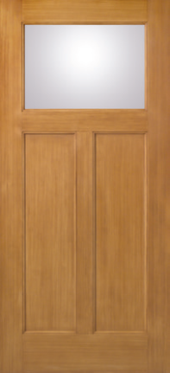
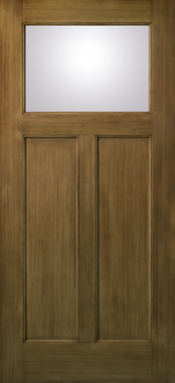
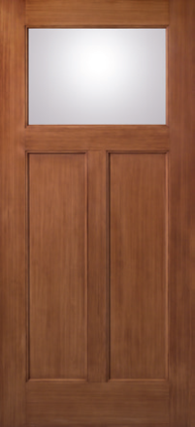
Classic-Craft® American Style Collection™
Classic-Craft® American Style CollectionTM
Vertical Douglas Fir grain.
The simple vertical lines and Shaker-style recessed panels
of Classic-Craft American Style premium fiberglass entryways create a timeless look perfect for Craftsman-inspired Cottage- and Bungalow-style homes.
Same-Day® Stain Finish Colors
Light Oak
Walnut
Mahogany
Cedar
Natural Oak
English Walnut
Cherry
Optional Dentil Shelf
Available option for all American Style Collection doors.
Natural Oak
English Walnut
Cherry
4-Block Dentil Shelf
16-Block Dentil Shelf

Slide 11
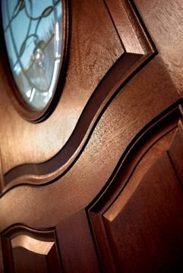
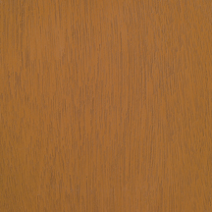
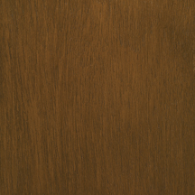
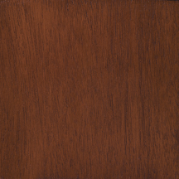
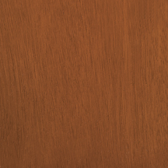
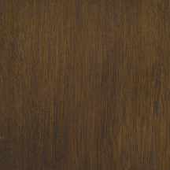
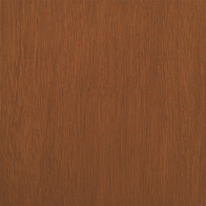
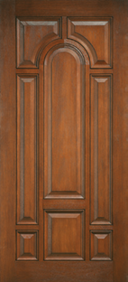
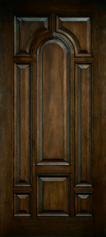
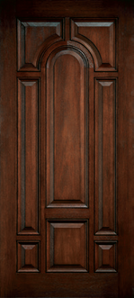
Classic-Craft® Mahogany CollectionTM
Classic-Craft® Mahogany CollectionTM
Rich, warm Mahogany wood tones.
Especially suited to European, Victorian and Colonial home styles, Classic-Craft Mahogany premium fiberglass entryways are a sophisticated, elegant option for homeowners looking to make a statement by creating dramatic, grand entrances.
Same-Day® Stain Finish Colors
Light Oak
Walnut
Mahogany
Cedar
Natural Oak
English Walnut
Cherry
Cedar
English Walnut
Mahogany

Slide 12
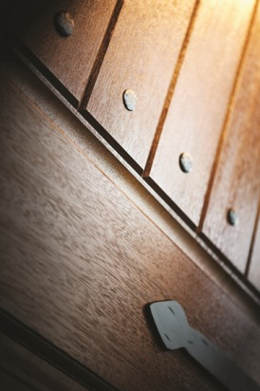
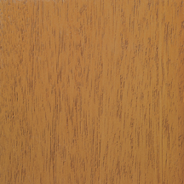
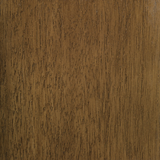
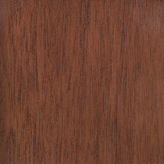
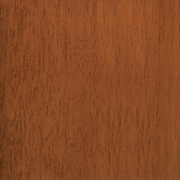
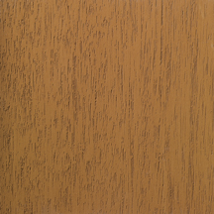
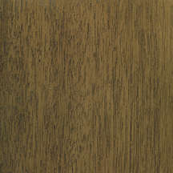
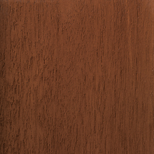
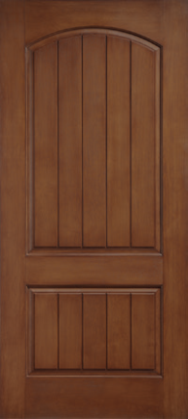
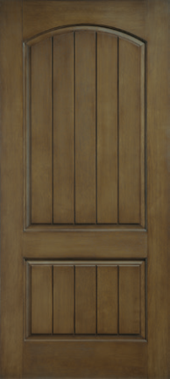
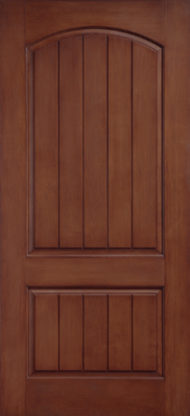
Classic-Craft® Rustic CollectionTM
Classic-Craft® Rustic CollectionTM
Casually elegant wood graining.
Designed to complement American Southwest or Tuscan-inspired home styles, Classic-Craft Rustic premium fiberglass entryways feature casually elegant wood graining that can be coordinated with decorative glass and accessories to create enchanting entrances.
Same-Day® Stain Finish Colors
Light Oak
Walnut
Mahogany
Cedar
Natural Oak
English Walnut
Cherry
Cherry
English Walnut
Mahogany

Slide 13
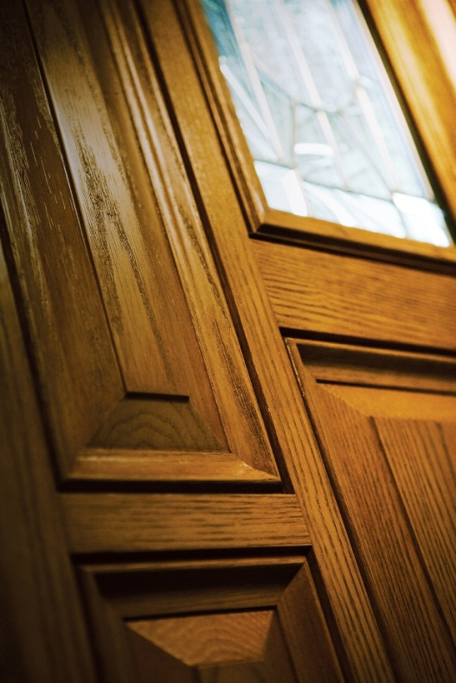
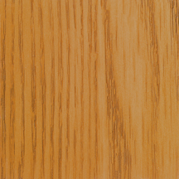
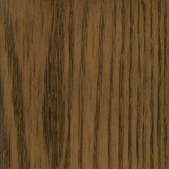
Classic-Craft® Oak CollectionTM
Classic-Craft® Oak CollectionTM
Warm, Oak grain.
With warm wood graining, Classic-Craft Oak premium fiberglass entryways are designed as the perfect complement to homes with traditional styling.
Same-Day® Stain Finish Colors
Light Oak
Walnut
Mahogany
Cedar
Natural Oak
English Walnut
Cherry
Light Oak
English Walnut
Cherry

Slide 14
Classic-Craft® Canvas Collection®
Classic-Craft® Canvas Collection®
Premium paintable surfaces.
The first premium smooth, paintable fiberglass door to carry the Therma-Tru® brand name, Classic-Craft Canvas is designed for homeowners seeking the aesthetics of a sleek, modern entryway that can be adapted to suit multiple styles.
Cream
Green
Optional Dentil Shelf
Available option for all Craftsman-style Canvas Collection doors.
4-Block Dentil Shelf
Teal

Slide 15
Classic-Craft® Clavos & Strap Hinges
Optional Clavos & Strap Hinges
Add a finishing touch of Rustic flavor with decorative hardware in an authentic, hand-forged wrought iron look with a black finish. Includes pyramid & round clavos, and 18" strap hinges.

Slide 16
VillagerTM & HomewardTM
VillagerTM
Villager beautifully interprets the Craftsman chevron design with bronze waterglass, seeded glass, clear bevels, gray artique glass and caming. Artistically authentic in every detail.
Black Nickel
Glass Privacy Rating
Brushed Nickel
Black Nickel
Brushed Nickel
HomewardTM
The balanced Mission-style pattern of Homeward invites light to cascade through its distinctive clear bevels, seeded glass and gray artique glass. An ideal complement for a Transitional home design.
Black Nickel
Glass Privacy Rating
Brushed Nickel
Glass Privacy Rating
Black Nickel
Brushed Nickel

Slide 17
ArcadiaTM & Augustine®
ArcadiaTM
With its timeless petal design, Arcadia combines gray baroque glass, seeded glass, clear curved bevels and caming for a distinctive display that evokes a simpler time.
Glass Privacy Rating
Black Nickel
Brushed Nickel
Brass
Augustine®
Augustine’s swirl leaf design adds that touch of elegance. Made of round wrought iron and granite glass for the ultimate in privacy, Augustine pays homage to classic English styling.
Glass Privacy Rating
Note: Features lite frame with authentic wrought-iron look in black finish.
Wrought Iron

Slide 18
AshurstTM & BellaTM
AshurstTM
Ashurst recalls the familiar feel of American crafted sophistication. Clear bevels, double waterglass and caming come together to provide modest privacy with a traditional vibe.
Glass Privacy Rating
Black Nickel
Brushed Nickel
BellaTM
As its name suggests, Bella’s design is delicate and appealing, bringing together clear bevels, clear baroque glass, rainglass, seeded glass, bronze waterglass and caming.
Glass Privacy Rating
Bronze Waterglass / Black Nickel
Bronze Waterglass / Brushed Nickel

Slide 19
ArborwatchTM & BorrassaTM
ArborwatchTM
An eclectic interpretation of the Arts and Crafts movement, Arborwatch combines narrow reed glass, M seedy glass, waterglass and caming in a symmetrical arrangement accented by pale amber glass, amber artique glass and clear bevels.
Black Nickel
Brushed Nickel
Black Nickel
Brushed Nickel
Glass Privacy Rating
BorrassaTM
A statement of strength and beauty, Borrassa combines linear and curved wrought iron with hammered glass for the ultimate in privacy. Wrought iron decorative accents add an authentic Old World feel to this stately design.
Glass Privacy Rating
Wrought Iron

Slide 20
ProvincialTM & LongfordTM
ProvincialTM
A unique diamond-based motif features double waterglass, clear bevels and caming surrounded by a gray baroque glass border. Provincial captivates with stunning clarity.
Glass Privacy Rating
Black Nickel
Brushed Nickel
Brass
LongfordTM
The traditional design of Longford integrates a hint of a Celtic knot with seeded glass, clear bevels, granite glass and caming. A timeless design ideal for entries where modest privacy is desired.
Glass Privacy Rating
Black Nickel
Brushed Nickel

Slide 21
CambridgeTM & ZahaTM
CambridgeTM
Ornate and enchanting, Cambridge exhibits a traditional 19th century-inspired elegance with modest privacy using crystalline glue chip glass, clear curved bevels, double waterglass and caming.
Glass Privacy Rating
Black Nickel
Brushed Nickel
Brass
ZahaTM
Structured right angles are offset by dynamic curves in this high-energy design. Zaha features oceana and seedy glass, clear and multifaceted bevels, and caming to create a refreshing and unexpected elegance that appeals to Contemporary home styles.
Glass Privacy Rating
Black Nickel
Brushed Nickel

Slide 22
Lucerna®
Lucerna®
Named for the beauty of light it reflects, Lucerna glass presents an elegant, updated fleur-de-lis pattern in a spectrum of curved, diamond and rectangular bevels surrounded by smooth, swirling barn wood and heavily textured diamond border glass.
Glass Privacy Rating
Black Nickel
Brushed Nickel
Privacy Glass
See Slide 37.

Slide 23
Classic-Craft® Decorative Glass: Discontinued
HazeltonTM
Inspired by traditional Arts and Crafts design, Hazelton uses medium amber artique glass, iridescent, rainbow-hued seeded glass, clear bevels, pale amber rough rolled glass and caming to create a welcoming warmth.
Brushed Nickel
Black Nickel
Glass Privacy Rating
BellaTM Granite
As its name suggests, Bella’s design is delicate and appealing, bringing together clear bevels, clear baroque glass, rainglass, seeded glass, granite glass and caming.
Glass Privacy Rating
Granite Glass / Brushed Nickel
Granite Glass /
Brushed Nickel

Slide 24
Door Selections: Fiber-Classic® Collections and Smooth-Star®
Generic Gray
Fiber-Classic®
Fiber-Classic® Mahogany CollectionTM
Fiber-Classic® Oak CollectionTM
Smooth-Star®
Mahogany CollectionTM
Oak CollectionTM
Smooth-Star®
Fiber-Classic® Blue
Smooth-Star® Blue
Fire-Rated Options
WBDR / HVHZ Options
Tru-Defense Eligible

Slide 25
Fiber-Classic® Mahogany CollectionTM & Oak CollectionTM
Wood grains to suit any style.
Choose from two wood-grained collections for the perfect fiberglass door to fit a variety of home styles at an excellent value. Fiber-Classic Mahogany complements rich wood tones in home interiors, extending the look to the outside with beauty and elegance. Fiber-Classic Oak is the door that started the fiberglass revolution, featuring the distinctive look of natural Oak graining.
Fiber-Classic® Mahogany
Same-Day® Stain Finish Colors
Light Oak
Natural Oak
Walnut
English Walnut
Mahogany
Cherry
Cedar
Optional Dentil Shelf*
Available option for all Craftsman-style Fiber-Classic Mahogany doors.
Fiber-Classic® Oak
4-Block Dentil Shelf
*Not recommended for placement behind storm doors.
Same-Day® Stain Finish Colors
Light Oak
Natural Oak
Walnut
Mahogany
Cherry
Cedar
English Walnut
Walnut
English Walnut

Slide 26
Smooth-Star®
Smooth, paintable surfaces.
Smooth-Star is the answer when the best look for the home is delivered in a sleek, paintable package. The more attractive and durable alternative to steel, Smooth-Star fiberglass doors are ready-to-paint with crisp, clean contours that meet the needs of homeowners seeking more color options for their doorways.
Optional Dentil Shelf*
Available option for all Craftsman-style Smooth-Star doors.
4-Block Dentil Shelf
*Not recommended for placement behind storm doors.

Slide 27
Blackstone® & CrystallineTM
Blackstone®
Traditional English design meets clear curved bevels, rainglass and caming to create the distinctive styling of Blackstone. Entries get the best of both privacy and simple refinement.
Glass Privacy Rating
Black Nickel
Brushed Nickel
CrystallineTM
This time-honored design features geometric styling brought to life with glue chip glass, glue chip bevels, clear bevels and caming. Offering modest privacy, Crystalline is a shining example of traditional decorative glass with lasting beauty.
Glass Privacy Rating
Black Nickel
Brushed Nickel
Brass

Slide 28
Sedona & Salinas®
Sedona
Art meets glass in Sedona where Arts and Crafts simplicity is designed with slump glass, clear bevels, clear artique glass and caming. Sedona Art glass featuring ruby red granite glass is also available with black nickel caming.
Glass Privacy Rating
Art Glass / Black Nickel
Black Nickel
Brushed Nickel
Salinas®
Oceana glass and wrought iron come together to create a cheerful entry glass design that offers the ultimate in privacy with yesterday’s charm.
Glass Privacy Rating
Wrought Iron

Slide 29
Element & Maple Park®
Element
Clean lines and contemporary styling make Element the ideal choice for entries with a modern aesthetic. Modest privacy is achieved with the red and white wispy glass surrounded by black nickel caming.
Glass Privacy Rating
Black Nickel
Note: Element glass is designed as a continuous configuration with left and right sidelites for a stunning mural-like entry door. The glass is shown photographed on a dark background to highlight the marble-like white wispy art glass.
Maple Park®
With hints of Mission style and the American Southwest, Maple Park provides a sophisticated appearance with waterglass, clear bevels, granite glass and caming. The curved design adds unique appeal.
Glass Privacy Rating
Black Nickel
Brushed Nickel

Slide 30
Avonlea® & SaratogaTM
Avonlea®
The dainty leaf design seemingly grows upward in this elegant glass design. Light pours through Avonlea’s clear baroque glass and bronze waterglass surrounded by black nickel caming.
Glass Privacy Rating
Black Nickel
SaratogaTM
Saratoga evokes a certain urban sophistication while offering modest privacy with its clear bevels, diamond glass, reed glass and caming. The geometric pattern bridges both modern and traditional designs.
Glass Privacy Rating
Black Nickel
Brushed Nickel

Slide 31
Arden® & Texas Star
Arden®
Reminiscent of historic leaded glass with modern sensibilities, Arden glass features an architectural pattern of smooth, wavy frosted delta glass, lightly textured chinchilla glass and elegant diamond bevels with flexible options to customize accent glass textures and caming.
Red Waterglass / Brushed Nickel
Glass Privacy Rating
Red Waterglass /
Black Nickel
Granite Glass /
Black Nickel
Granite Glass /
Brushed Nickel
Texas Star
Beautifully crafted with clear bevels, curved bevels, clear waterglass, granite glass, glue chip glass and brushed nickel caming, there’s no mistaking the inspiration for this recognizable design. Strong, independent and all-American.
Glass Privacy Rating
Brushed Nickel

Slide 32
WellesleyTM & ConcordeTM
WellesleyTM
Simple yet charming, Wellesley’s Victorian-inspired design uses clear baroque glass, clear bevels, waterglass, granite glass and caming to add beauty to any entry.
Glass Privacy Rating
Black Nickel
Brushed Nickel
Brass
ConcordeTM
There’s just something friendly about Concorde’s cheery four-leaf design. Glue chip glass, clear curved bevels, clear glass and caming make up its Old World charm.
Glass Privacy Rating
Black Nickel
Brushed Nickel
Brass

Slide 33
KensingtonTM & Crystal DiamondsTM
KensingtonTM
Kensington speaks European elegance while offering modest privacy with its clear bevels, glue chip glass, granite glass and caming.
Glass Privacy Rating
Black Nickel
Brushed Nickel
Crystal DiamondsTM
Perfect for the place where friends and families meet. And with its glue chip glass, clear bevels and brass caming, Crystal Diamonds provides privacy with a welcoming touch.
Glass Privacy Rating
Brass

Slide 34
AxisTM & BevellineTM
AxisTM
Simple and smart, Axis combines narrow reed glass in horizontal and vertical arrangements to create contrast and modest privacy. A vertical band of clear glass bevels completes this linear design, ideal for Modern home styles.
Glass Privacy Rating
Black Nickel
BevellineTM
Bevelline glass features designs that create the look of fine-cut facet crystal.
Glass Privacy Rating

Slide 35
Frosted Images® / Internal Blinds / Screens
Frosted Images®
Delicate and ornate, Frosted Images offers a high privacy rating with an elegant aesthetic achieved with the simplicity of white-frosted glass.
Glass Privacy Rating
Internal Blinds
Internal blinds provide the privacy and convenience of a cordless blind enclosed between glass. A single-handed operator opens, closes and tilts the blinds to control the desired level of privacy and light. Low-E glass option available.
Screen Vented
Screen vented lites offer a built-in screen for ventilation, featuring a gliding operation and sash locking system.

Slide 36
FC & SS Decorative Glass: Discontinued
KeystoneTM
Reminiscent of the Victorian age, Keystone uses swirled gray baroque glass, clear curved bevels and caming to create an exquisite, time-honored design with historical significance.
Glass Privacy Rating
Brushed Nickel
Brass

Slide 37
Privacy Glass
Chord Glass
A vertical flowing pattern reminiscent of waves on the water.
Chinchilla Glass
A free-flowing configuration, presenting quiet lines and curves.
Glass Privacy Rating
Glass Privacy Rating
Rainglass
An elegantly fashioned glass, featuring ripples of cascading water.
Granite Glass
A coarse grained arrangement with surface detail over the entirety of glass.
Glass Privacy Rating
Glass Privacy Rating

Slide 38
Glass Shapes with Divided Lites
SDL Bar Options
GBG Bar Options
Color Options
Fiber-Classic
Smooth-Star
Flat
Contour
White
Almond
Bronze
Stone*
Tan*
*Available in Special Quote Program.

Slide 39
Door Selections: Steel
ProfilesTM
Traditions
ProfilesTM
Versatile, affordable options.
Coupling distinctive styling with affordability, Profiles steel doors offer versatile front entry and house-to-garage options that are designed to match multiple home styles.
Traditions
Back to basics.
It’s back to basics with Traditions. This line of steel doors combines attractive designs and value-based options to create a great, cost-conscious alternative for multiple front entry and house-to-garage configurations.
Door & Glass
Glass
Door
ProfilesTM & Traditions Red
Generic Gray

Slide 40
Door Selections: Pulse®
Pulse®
Ari
Línea
Echo
Solei
Material Choices
Wood-Grained Fiberglass: Mahogany or Oak
(Shown in Light Oak stain.)
Smooth
Fiberglass
Steel
Ari
Línea
Echo
Solei
Sidelites
Pulse® Dark Brown
Generic Gray
Fiberglass
Steel
Ari
Línea
Echo
Solei

Slide 41
Therma-Tru® Door Systems
Lifetime Limited Warranty
We stand behind more parts of a door system for longer than other door companies because we make or specify everything that goes into it. A Therma-Tru fiberglass door system is backed by the industry’s most comprehensive lifetime limited warranty.
Energy Efficiency
In any region or climate, energy efficiency is key. Thousands of Therma-Tru door and glass options are ENERGY STAR® qualified and National Fenestration Rating Council (NFRC) certified, helping save money on energy costs.
Quality Testing
Our doors, glass and components are held to high standards. We conduct thorough testing to guarantee that our products will live up to a homeowner’s toughest quality and performance expectations.
Note: See your Therma-Tru seller or visit www.thermatru.com for details on limited warranties and exclusions, and ENERGY STAR qualified products.

Slide 42
Tru-Defense®
Tru-Defense: The Ultimate Protection
Therma-Tru fiberglass doors are available with our exclusive Tru-Defense® system, which integrates specific components engineered and tested to deliver outstanding protection in all kinds of weather conditions. And it’s backed by a Warranty Rider that provides for cash reimbursement that may be used toward secondary damage to flooring and trim, and the labor to make repairs if water infiltration occurs.*
For details, visit www.thermatru.com/trudefense.
Water Infiltration Cash Reimbursement Limit
Latch and Deadbolt Lock with Standard Assembly: with a Therma-Tru Sill Pan: | $250 $500
Multi-Point Lock with Standard Assembly: with a Therma-Tru Sill Pan: | $750 $1,500
Multi-Point Lock with NAFS-Certified Assembly: with a Therma-Tru Sill Pan: | $1,000 $2,000
*For full details on the Tru-Defense Warranty Rider, visit www.thermatru.com/trudefense. The Rider does not warrant workmanship of anyone who assembles or installs a Tru-Defense door system, nor any damages caused by improper handling, assembly or installation.

Slide 43
Low-E Glass
Low-E Glass
Factory-coated Low-E glass, available as an option for clear glass, delivers exceptional energy efficiency. All Classic-Craft and Pulse clear glass is Low-E. And Low-E is available for clear glass in Fiber-Classic, Smooth-Star, Profiles and Traditions.
In cold weather, Low-E glass reduces the loss of heat by reflecting the heat back inside the home.
In warm weather, Low-E glass reflects the sun’s rays off of the glass, keeping the interior of the home cool.

Slide 44
Hardware
Handleset Options for Standard Door Multi-Point Locking System
Heirloom
Venture
Millennium
Ara
Decade
Handlesets Shown:
Top: Wide Back Active & Bottom: Narrow Back Inactive
Finish Options
Bright Brass
Antique Brass
Brushed Nickel
Black Nickel
Antique Nickel
Polished Chrome
Oil-Rubbed Bronze
White (Narrow Handlesets Only)

Slide 45
Additional Tools
Door Sizes
2'0" x 6'8" 2'10" x 6'6"
2'0" x 8'0" 2'10" x 6'8"
2'4" x 6'6" 2'10" x 7'0"
2'4" x 6'8" 2'10" x 8'0"
2'4" x 8'0" 3'0" x 6'6"
2'6" x 6'6" 3'0" x 6'8"
2'6" x 6'8" 3'0" x 7'0"
2'6" x 8'0" 3'0" x 8'0"
2'8" x 6'6" 3'6" x 6'8"
2'8" x 6'8" 3'6" x 8'0"
2'8" x 7'0"
2'8" x 8'0"
Sidelite Sizes
10" x 6'8"
12" x 6'6"
12" x 6'8"
12" x 7'0"
12" x 8'0"
14" x 6'6"
14" x 6'8"
14" x 7'0"
14" x 8'0"
Options
No Stile Lines
Low-E Glass (LE)
Black Nickel Caming (1D)
Brushed Nickel Caming (1C)
Brass Caming (1A)
Wrought Iron (1W)
Flush-Glazed Glass (FG)
Simulated Divided Lites (SDL)*
Flat or Contour, White or Color Grilles Between Glass (GBGF / GBGC)
Flat White Grilles Between Glass Only (GBGFW)
Fixed Grilles (FXG)
Removable Wood Grilles (RG)
PVC Doorlite Frame*
Vented Sidelite (No Impact) (6'6" & 6'8" only in 12" & 14") (8'0" only in 14")
Turtle Glass
WBDR Options**
WBDR / HVHZ Options**
Therma-Tru Fire-Rated Doors
90-Minute Steel Edge
20-Minute Fiberglass
20-Minute ProfilesTM Wood-Edge
20-Minute Traditions Wood-Edge
*Not recommended for use behind storm doors or to be painted dark colors, if exposed to direct sunlight. (Disclaimer only needed for Fiber-Class & Smooth-Star.)
**Please verify that there is a Therma-Tru product approval for the configuration before buying.
Same-Day® Stain All-Inclusive Kit
Contains everything to stain a Therma-Tru fiberglass double door system or a single door with two sidelites.*
*Actual coverage may vary based on product selected, application method and desired appearance.
Finishing Video
Watch easy-to-follow instructions at www.samedaystain.com (Right click, select ‘Open Hyperlink’).

